Slide 1
UNIT-4
SWITCH GEAR

Slide 2
Fuse
The electrical equipment are designed to carry a particular rated value of current under normal conditions. Under abnormal conditions such as short circuits, overload, or any fault; the current rises above this value, damaging the equipment and sometimes resulting in fire hazard. Fuses come into operation under fault conditions.
A fuse is short piece of metal, inserted in the circuit, which melts when excessive current flows through it and thus breaks the circuits. Under normal operating conditions it designed to carry the full load current. If the current increases beyond this designed value due to any of the reasons mentioned above, the fuse melts, isolating the power supply from the load.

Slide 3
Desirable characteristics of a Fuse Element:
The material used foe fuse wires must have the following characteristics:
i. Low melting point e.g., tin, lead.
ii. High conductivity e.g., copper.
iii. Free from deterioration due oxidation e.g.,
silver.
iv. Low cost e.g., tin, copper.

Slide 4
Materials used for Fuse
Material used is tin lead or silver having low melting points.
Use of copper or iron is dangerous, though tinned copper may be used.

Slide 5
Types of Fuses
Fuses are classified into following types
(i) Re-wireable or kit-Kat fuse and
(ii) High rupturing capacity (H.R.C) cartridge fuse

Slide 6
Re-wireable or Kit-Kat Fuse
Re-wireable fuse is used where low values of fault current are to be interrupted. These fuses are simple in construction, cheap and available up to a current rating of 200A.They are erratic in operation and their performance deteriorates with time. An image of re-wireable fuse is as shown in figure

Slide 7
High Rupturing Capacity (HRC) Cartridge Fuse
It consists of a heat resisting ceramic body having metal end- caps to which a silver current-carrying element is welded. The space within the body surrounding the elements is completely packed with a filling powder. The filling material my be chalk, plaster of Paris, quartz or marble dust and acts as an arc quenching and cooling medium.
Therefore, it carries the normal current without overheating Under normal loading conditions, the fuse element is at a temperature below its melting point. When a fault occurs, the current increases and the fuse element melts before the fault current reaches its first peak. The heat produced in the process vaporizes the melted silver element. The chemical reaction between the silver vapors and the filling powder results in the formation of a high resistance substance which helps in quenching the arc.

Slide 9
Circuit Breaker
Electrical circuits breaker is a switching device which can be operated manually and automatically for the controlling and protection of electrical power system, respectively. The modern power system deals with a huge power network and huge numbers of associated electrical equipments. During shirt circuits fault or any other type of electrical fault, these equipments, as well as the power network, suffer a high stress of fault current, which in turn damage the equipment and networks permanently.
For saving these equipment and the power networks, the fault current should be cleared from the system as quickly as possible. Again after the cleared, the system must come to its normal working condition as soon is possible for supplying reliable quality power to the receiving ends. The circuits breaker is the special device all the required switching operations during current carrying condition.

Slide 10
A circuit breaker essentially consists of fixed and moving contacts, called electrodes. Under normal operating conditions, these contacts remain closed and will not open automatically until and unless the system becomes faulty. The contacts can be opened manually or by remote control whenever desired. When a fault occurs in any part of the system, the trip coils of the breaker get energized and the moving contacts are pulled apart by some mechanism, thus opening the circuits.

Slide 11
Types of circuits breakers
Miniature circuit breaker (MCB)
Earth leakage circuit breaker (ELCB) or Residual Current Breaker (RCCB)
Air blast Circuit Breaker (ACB)
Molded Case Circuit Breaker (MCCB)
Vacuum Circuit Breaker (VCB)
SF6 Circuit Breaker

Slide 12
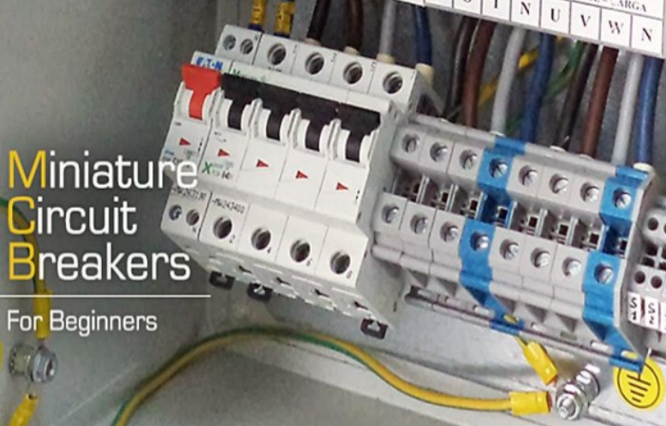
MCB

Slide 13
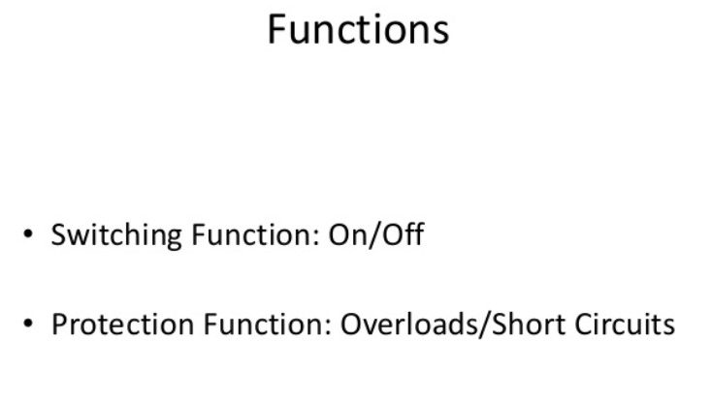

Slide 14
Miniature Circuit Breaker (MCB)
Minimum circuit breaker is a electromechanical device which protect an electrical circuit from overcurrent.
Over currents in an electrical circuits may results from short circuits overload, or faulty design.
An MCB is better alternative than fuse, since it does not require replacement once an overload is detected.
An MCB functions by interrupting the continuity of electrical flow through the circuits once a fault is detected.
In simple terms, MCB is a switch which automatically turns off when the current flowing through it passes the maximum allowable limit.
Generally MCB is designed to protect against over current and over
temperature faults (over heating).

Slide 15
Working Principle
There are two contact - one is fixed and the other is moveable. When the current exceeds the predefined limit, a solenoid forces the moveable contact to open (i.e., disconnect from the fixed contact) and the MCB turns off, thereby stopping the current from flowing in the circuits.

Slide 16
Operation
An image of MCB is shown in figure (12.10) and internal parts of an MCB are shown in figure (12.11). It mainly consists of one bi- metallic strip, one trip coil and one hand operated on-off lever. Electric current carrying path of a MCB is as follows - first left hand side power terminal-then bimetallic strip - then current coil - then moving contact - then fixed contact and – lastly right hand side power terminal and all are arranged in series.

Slide 18
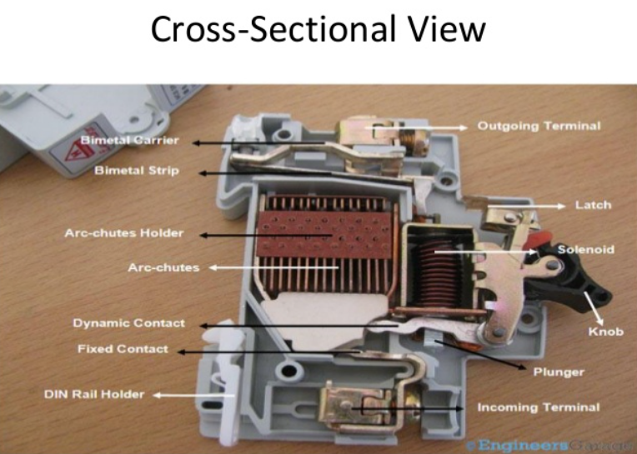

Slide 19
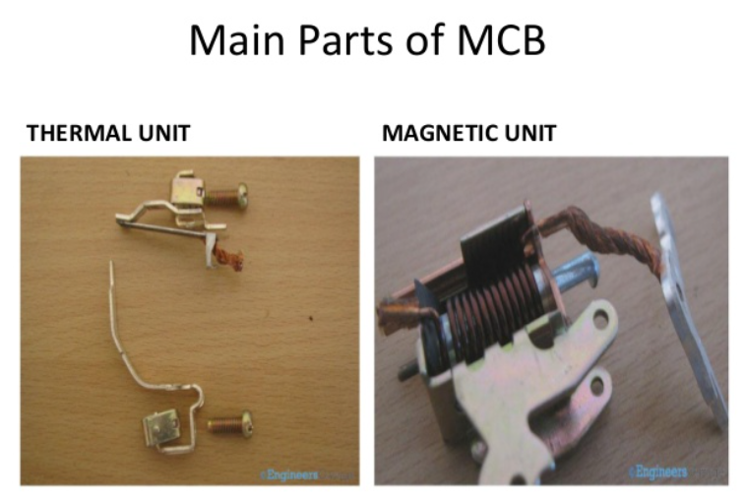

Slide 20
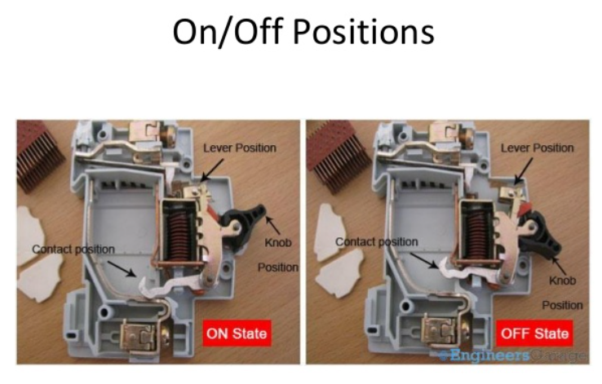

Slide 21
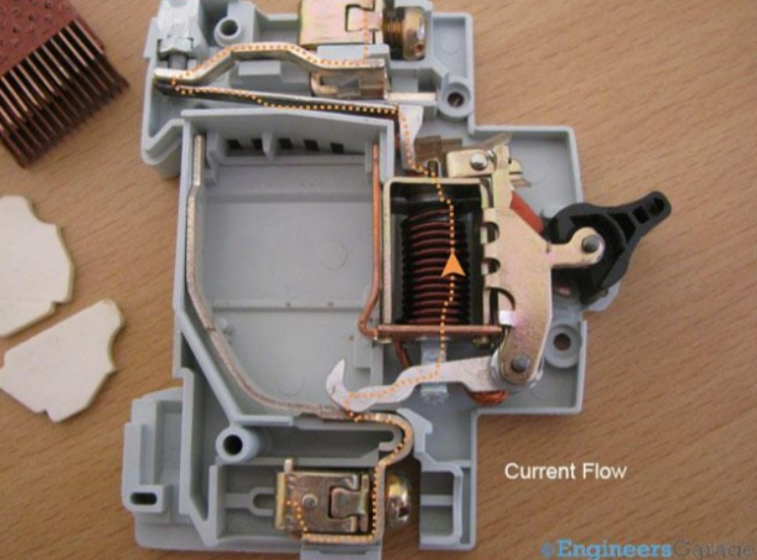

Slide 22
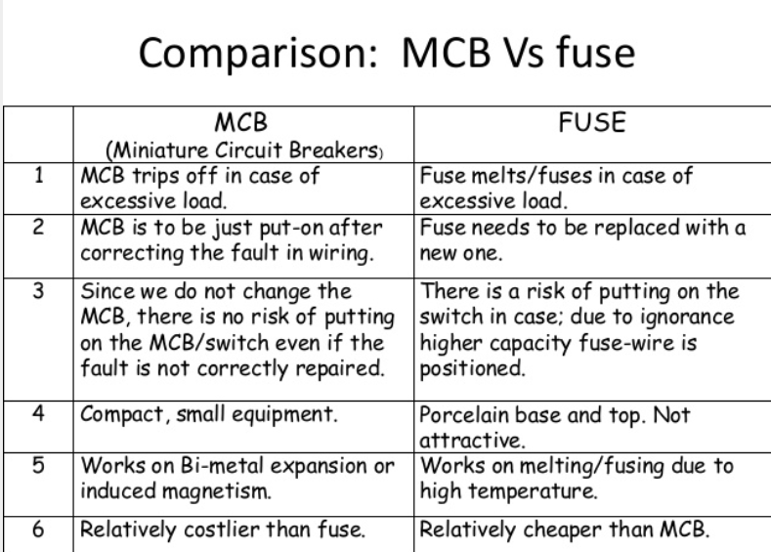

Slide 23
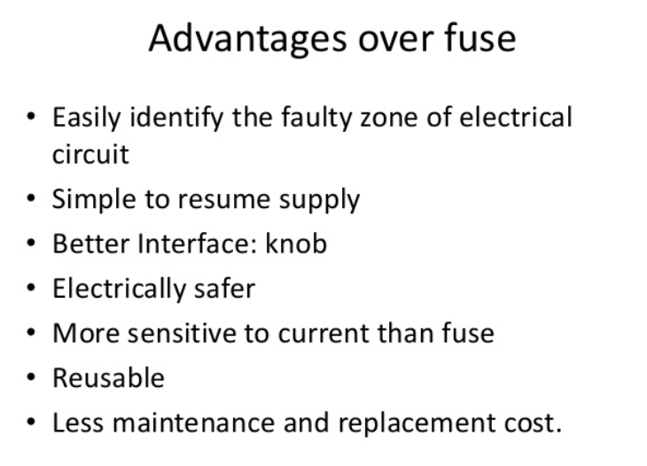

Slide 24
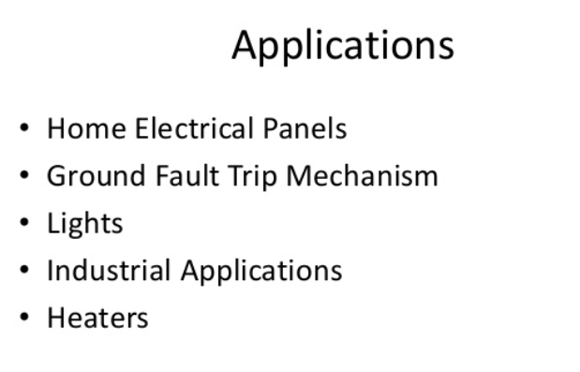

Slide 25
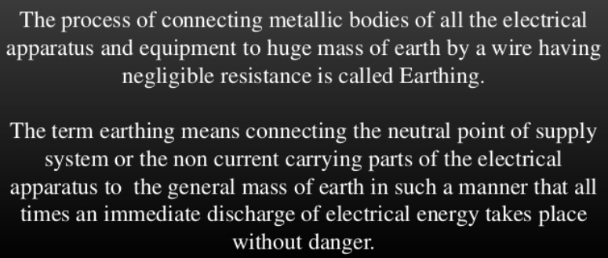
Earthing

Slide 26
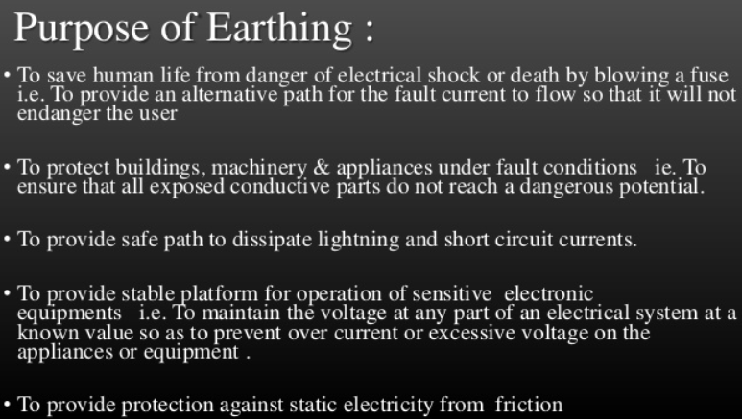
Earthing contd…

Slide 27
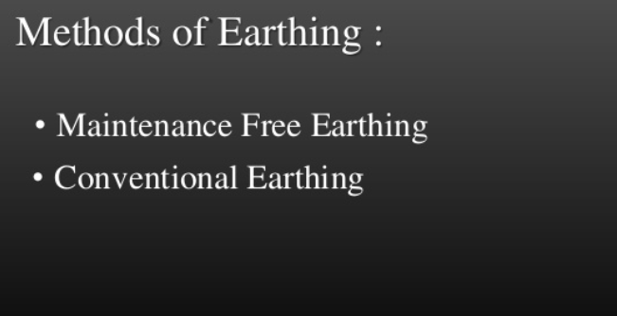
Earthing contd…

Slide 28
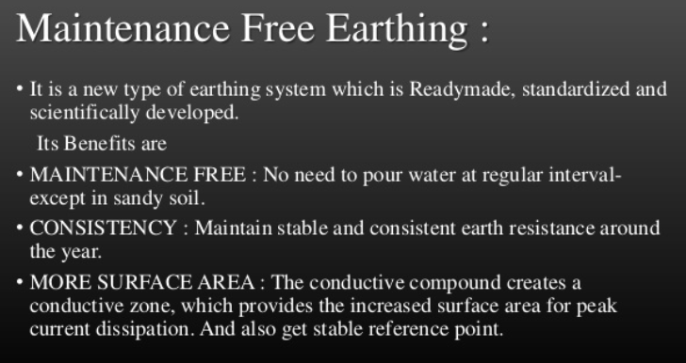
Earthing contd….

Slide 29
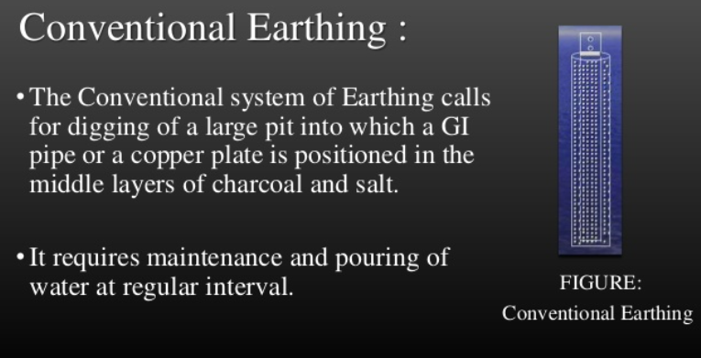
Earthing contd…..

Slide 30
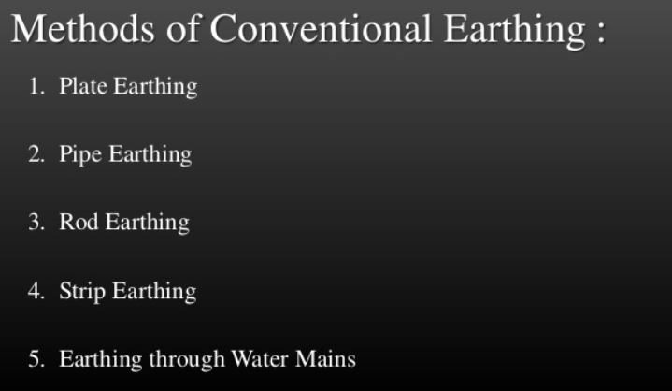
Earthing contd……

Slide 31
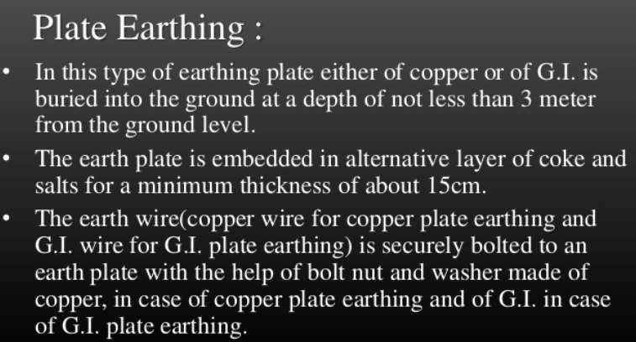
Earthing contd……

Slide 32
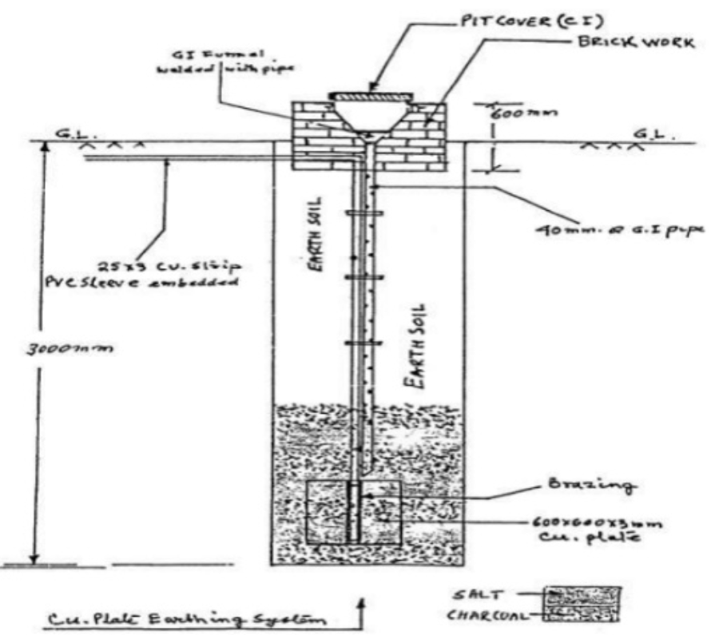
Plate Earthing

Slide 33
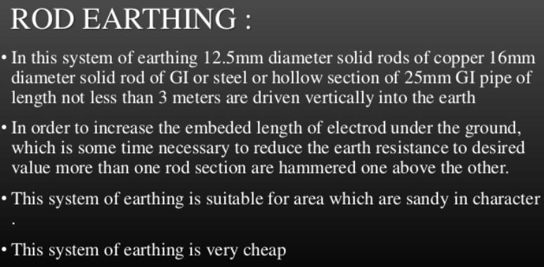

Slide 34
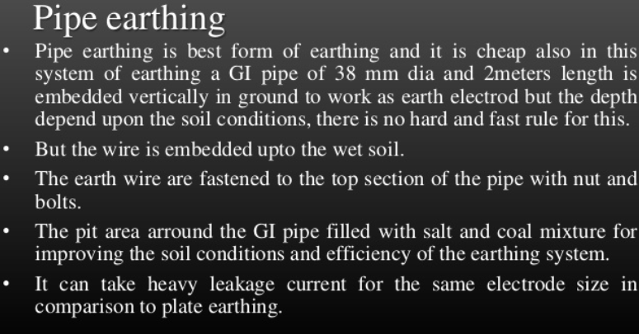

Slide 35
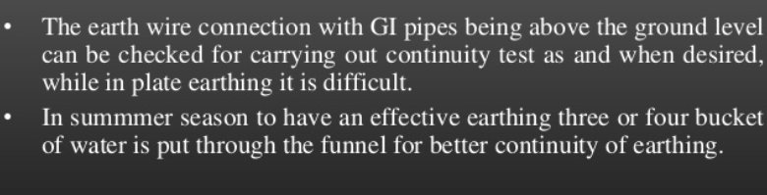
Pipe Earthing contd……

Slide 36
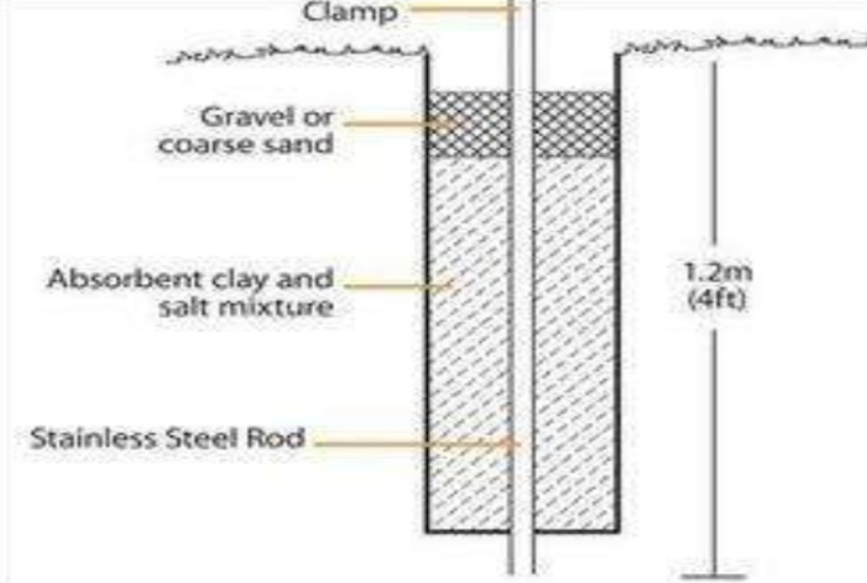
Pipe or rod earthing

Slide 37
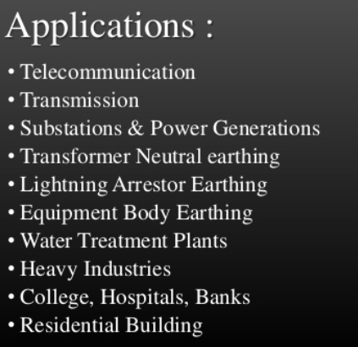

Slide 38
Power Factor Improvement

Slide 39
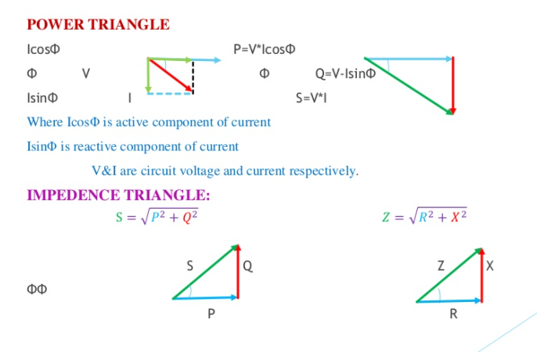

Slide 40
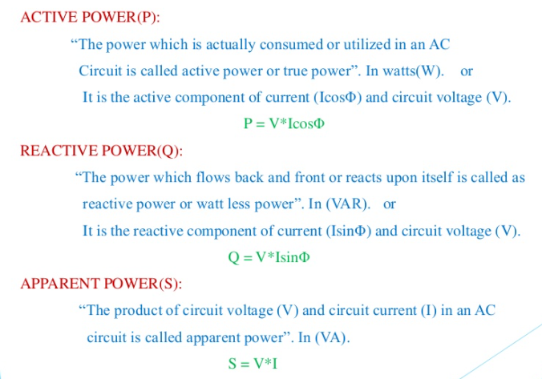

Slide 41
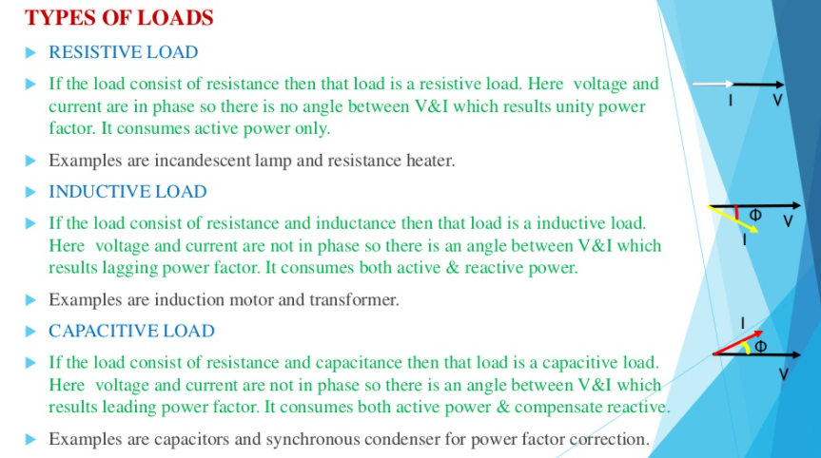

Slide 42
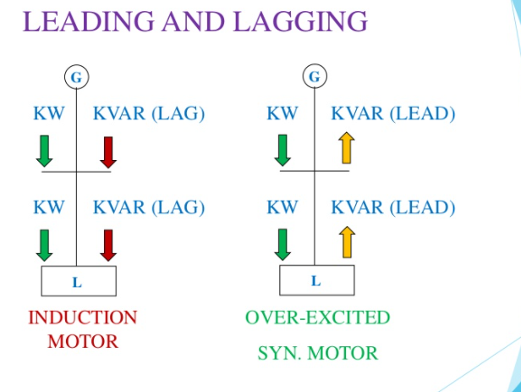

Slide 43
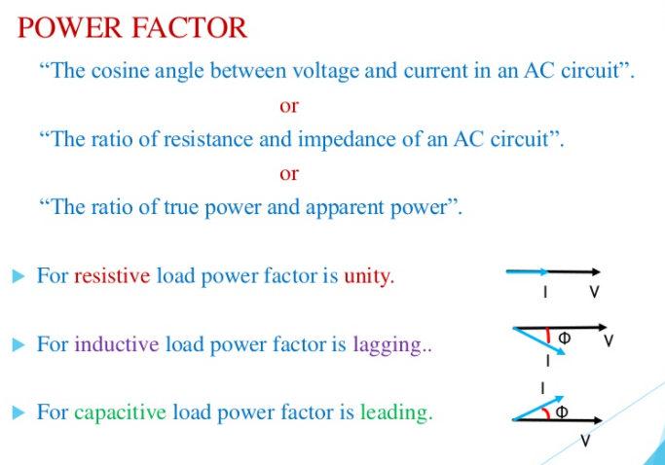

Slide 44
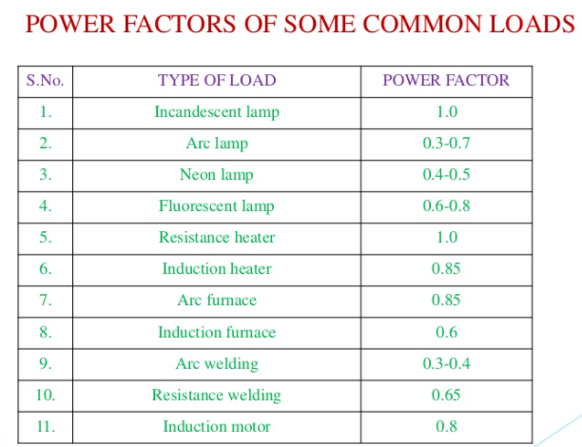

Slide 45
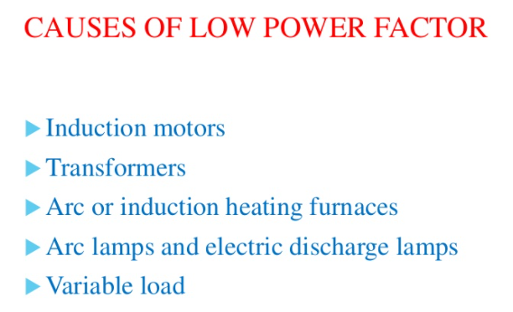

Slide 46
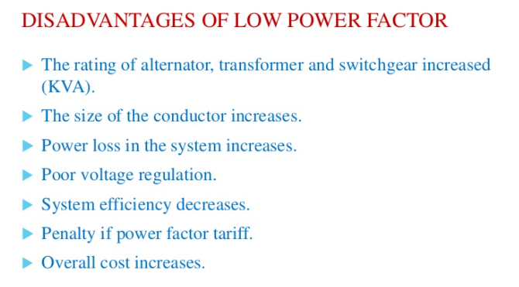

Slide 47
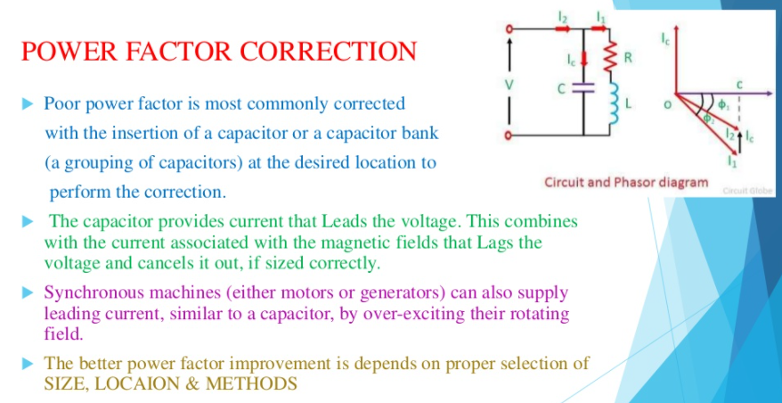

Slide 48
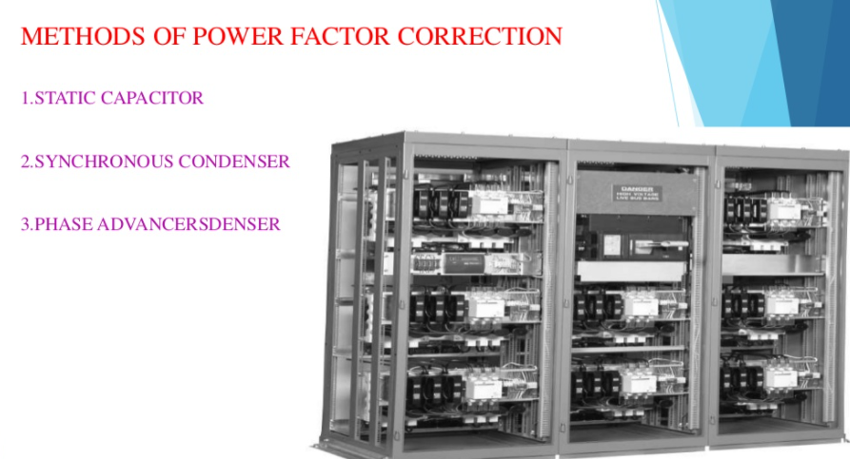

Slide 49
